Slide 1
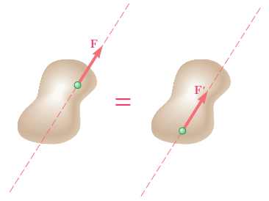
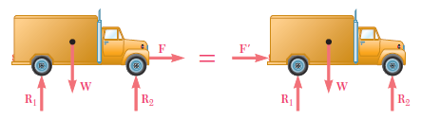
Principle of Transmissibility
The conditions of equilibrium or motion of a rigid body will remain unchanged if a force F acting at a given point of the rigid body is replaced by a force F' of the same magnitude and same direction, but acting at a different point, provided that the two forces have the same line of action

Slide 2
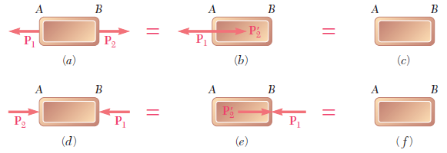
Principle of Transmissibility-Limitations

Slide 3
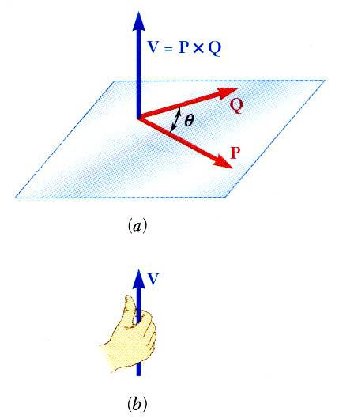
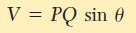
Vector Product of Two Vectors
Vector product of two vectors P and Q is defined as the vector V which satisfies the following conditions:
Line of action of V is perpendicular to plane containing P and Q.
Magnitude of V is
Direction of V is obtained from the right-hand rule.
Vector products are
not commutative,
distributive,
not associative

Slide 4
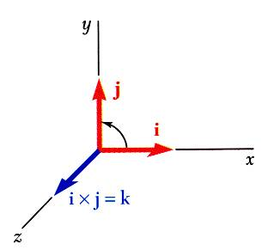
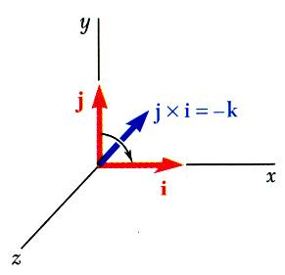
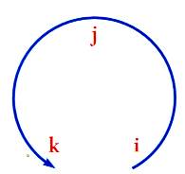
Vector Products: Rectangular Components

Slide 5
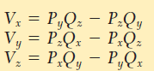

Slide 6
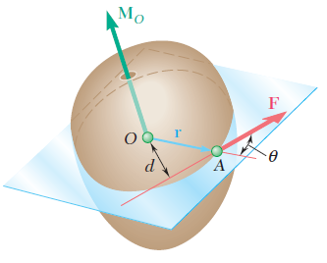
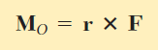
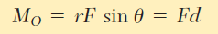
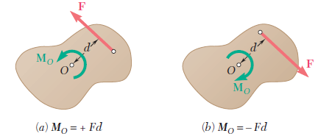
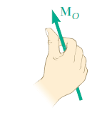
Moment of a force about a point
The magnitude of M_{O} measures the tendency of the force F to make the rigid body rotate about a fixed axis directed along M_{O}

Slide 7
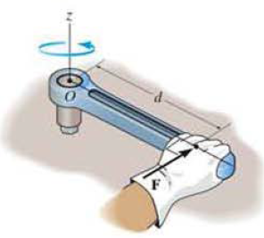
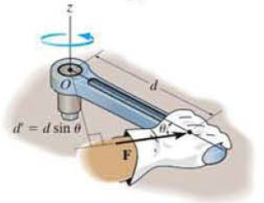

Slide 8
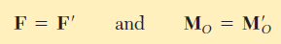
The principle of transmissibility can now be restated as
Two forces F and F' are equivalent if, and only if, they are equal (i.e., have the same magnitude and same direction) and have equal moments about a given point O

Slide 9
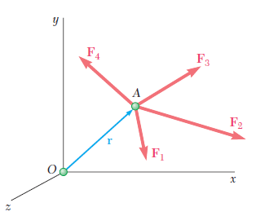
Varignon’s Theorem
The moment about a given point O of the resultant of several concurrent forces is equal to the sum of the moments of the various forces about the same point O
The moment of a force about any point is equal to the sum of the moments of the components of the force about the same point.

Slide 10
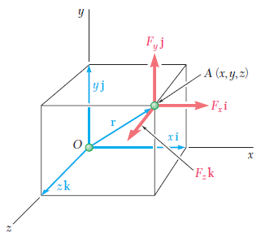
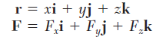
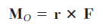
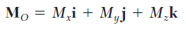
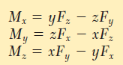
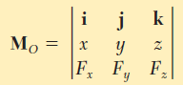
Rectangular components of the moment of a force

Slide 11
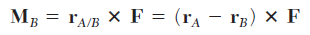
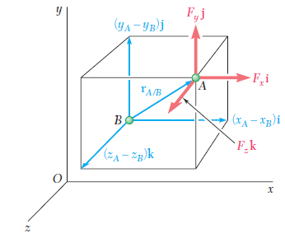
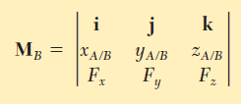

Slide 12
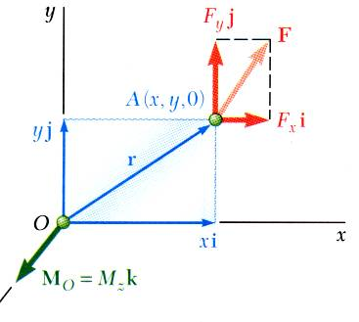
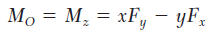
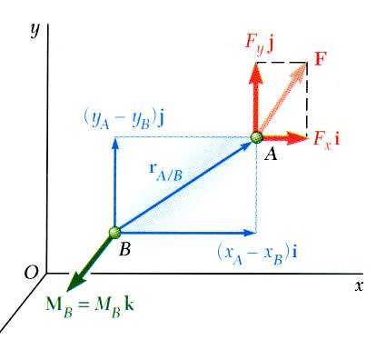
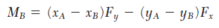
For 2D

Slide 13
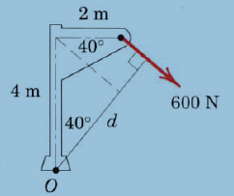
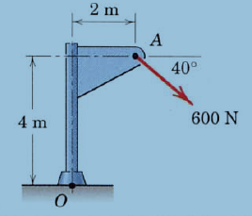
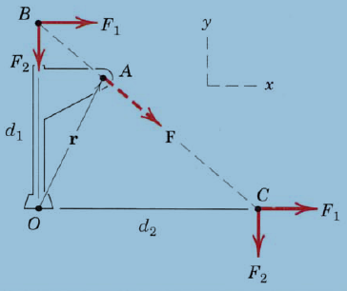
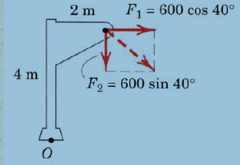
Problem 1
M_{O} = - 2610 N-m

Slide 14
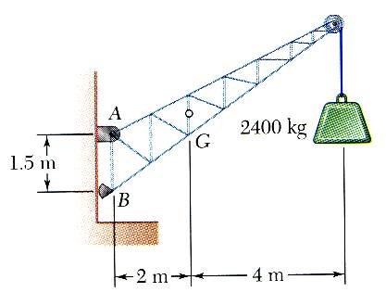
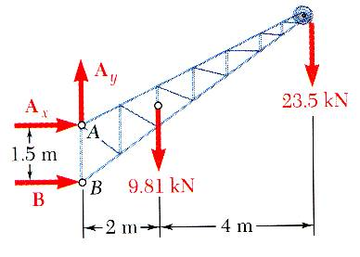
Free-Body Diagram
First step in the static equilibrium analysis of a rigid body is identification of all forces acting on the body with a free-body diagram.
Select the extent of the free-body and detach it from the ground and all other bodies.
Indicate point of application, magnitude, and direction of external forces, including the rigid body weight.
Indicate point of application and assumed direction of unknown applied forces. These usually consist of reactions through which the ground and other bodies oppose the possible motion of the rigid body.
Include the dimensions necessary to compute the moments of the forces.

Slide 15
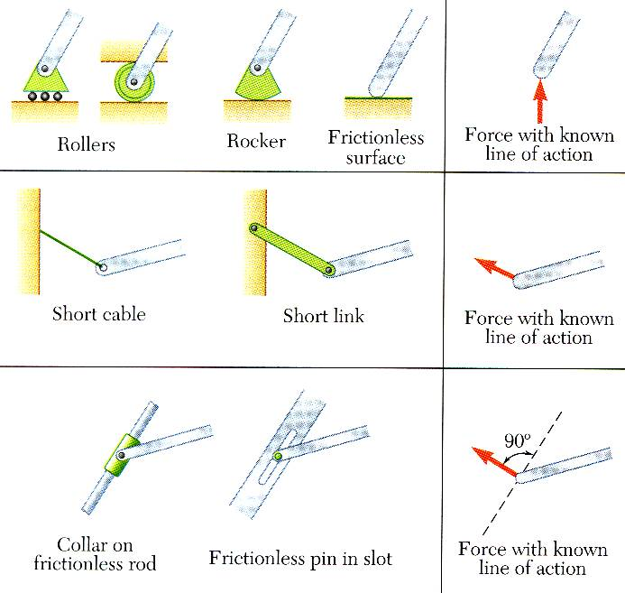
Reactions at Supports and Connections for a Two-Dimensional Structure
Reactions equivalent to a force with known line of action.

Slide 16
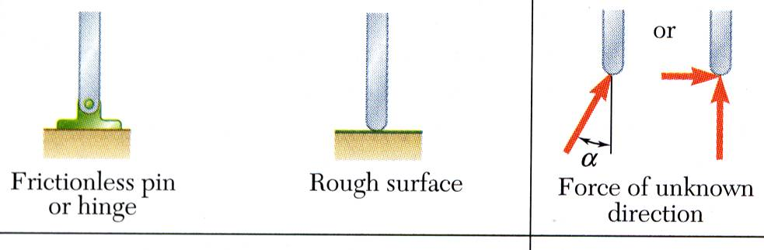
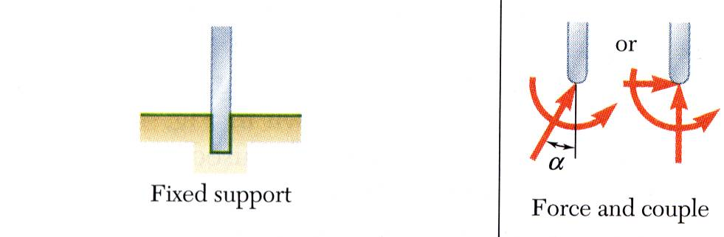
Reactions at Supports and Connections for a Two-Dimensional Structure
Reactions equivalent to a force of unknown direction and magnitude.
Reactions equivalent to a force of unknown direction and magnitude and a couple.of unknown magnitude

Slide 17
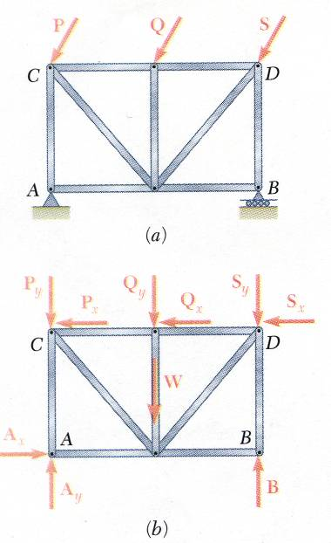
Equilibrium of a Rigid Body in Two Dimensions
For all forces and moments acting on a two-dimensional structure,
Equations of equilibrium become
where A is any point in the plane of the structure.
The 3 equations can be solved for no more than 3 unknowns.
The 3 equations can not be augmented with additional equations, but they can be replaced

Slide 18
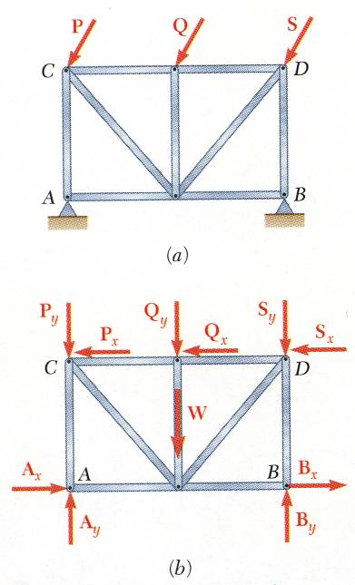
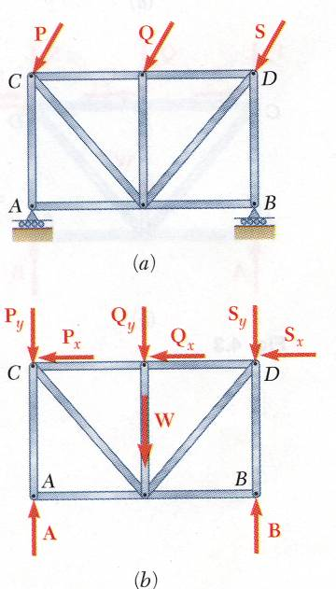
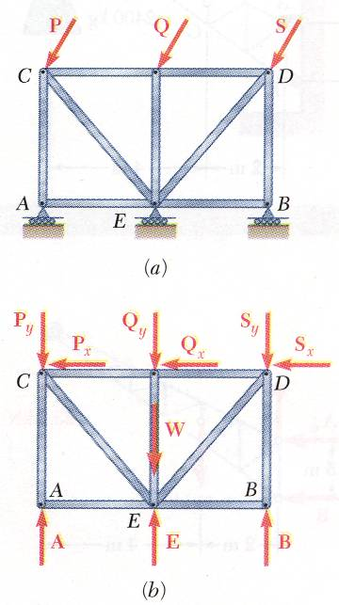
Statically Indeterminate Reactions
More unknowns than equations
Fewer unknowns than equations, partially constrained
Equal number unknowns and equations but improperly constrained

Slide 19
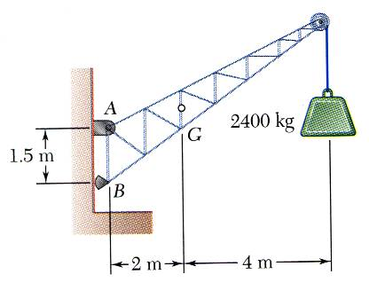
Sample Problem 4.1
SOLUTION:
Create a free-body diagram for the crane.
Determine B by solving the equation for the sum of the moments of all forces about A. Note there will be no contribution from the unknown reactions at A.
Determine the reactions at A by solving the equations for the sum of all horizontal force components and all vertical force components.
A fixed crane has a mass of 1000 kg and is used to lift a 2400 kg crate. It is held in place by a pin at A and a rocker at B. The center of gravity of the crane is located at G.
Determine the components of the reactions at A and B.
Check the values obtained for the reactions by verifying that the sum of the moments about B of all forces is zero.

Slide 20
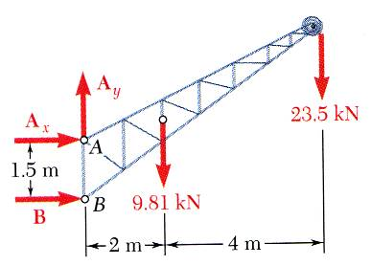
Determine B by solving the equation for the sum of the moments of all forces about A.
Determine the reactions at A by solving the equations for the sum of all horizontal forces and all vertical forces.
Create the free-body diagram.
Check the values obtained.

Slide 21
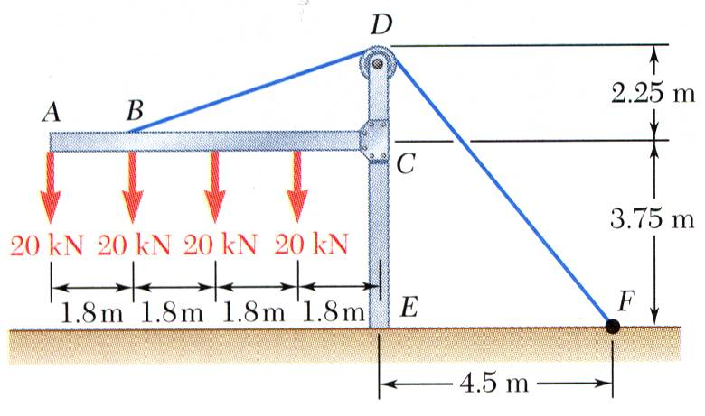
Sample Problem 4.4
SOLUTION:
Create a free-body diagram for the frame and cable.
Solve 3 equilibrium equations for the reaction force components and couple at E.
The frame supports part of the roof of a small building. The tension in the cable is 150 kN.
Determine the reaction at the fixed end E.

Slide 22
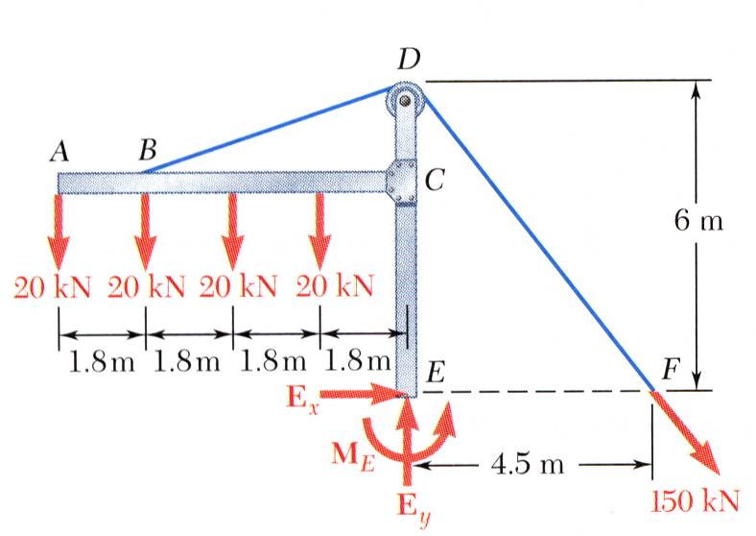
Sample Problem 4.4
Solve 3 equilibrium equations for the reaction force components and couple.
Create a free-body diagram for the frame and cable.

Slide 23
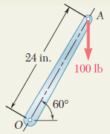
Problem 3
A 100-lb vertical force is applied to the end of a lever which is attached to a shaft at O. Determine
(a) the moment of the 100-lb force about O; 1200 lb-in.
(b) the horizontal force applied at A which creates the same moment about O; F = 57.7 lb
(c) the smallest force applied at A which creates the same moment about O; F = 50 lb
(d) how far from the shaft a 240-lb vertical force must act to create the same moment about O; x=10 in.
(e) whether any one of the forces obtained in parts b, c, and d is equivalent to the original force.

Slide 24
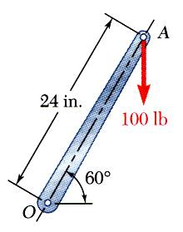
Solution
A 100-lb vertical force is applied to the end of a lever which is attached to a shaft at O.
Determine:
moment about O,
horizontal force at A which creates the same moment,
smallest force at A which produces the same moment,
location for a 240-lb vertical force to produce the same moment,
whether any of the forces from b, c, and d is equivalent to the original force.

Slide 25

a) Moment about O is equal to the product of the force and the perpendicular distance between the line of action of the force and O. Since the force tends to rotate the lever clockwise, the moment vector is into the plane of the paper.

Slide 26

b) Horizontal force at A that produces the same moment,

Slide 27

c) The smallest force A to produce the same moment occurs when the perpendicular distance is a maximum or when F is perpendicular to OA.

Slide 28

d) To determine the point of application of a 240 lb force to produce the same moment,

Slide 29
e) Although each of the forces in parts b), c), and d) produces the same moment as the 100 lb force, none are of the same magnitude and sense, or on the same line of action. None of the forces is equivalent to the 100 lb force.

Slide 30


Slide 31


Slide 32


Slide 33


Slide 34

Problem 4
A rectangular plate is supported by brackets at A and B and by a wire CD. Knowing that the tension in the wire is 200 N, determine the moment about A of the force exerted by the wire on point C.

Slide 35

SOLUTION:
The moment M_{A} of the force F exerted by the wire is obtained by evaluating the vector product,
The rectangular plate is supported by the brackets at A and B and by a wire CD. Knowing that the tension in the wire is 200 N, determine the moment about A of the force exerted by the wire at C.

Slide 36


SOLUTION:

Slide 37


Problem 5
A turnbuckle as shown in Figure is tightened until the tension in the cable AB is 1.2 kN. Determine the moment of the force about the point O.

Slide 38


Slide 39


Slide 40


Slide 41


Slide 43


Slide 44


Slide 46


Problem 6
A 200 N force is applied as shown to the bracket ABC (see Figure). Determine the moment of the force about A.
ANSWER:

Slide 47


Slide 48




SCALAR PRODUCT OF TWO VECTORS
The concept of moment of a force about an axis could be explained using dot product of vectors
scalar
Scalar product of two vectors is
Commutative
Distributive
Not Associative

Slide 49



P and Q – in Rectangular Components
From the definition of the scalar product
P . Q reduces to
When P and Q are equal

Slide 50




Applications
1) Angle formed by two given vectors
2) Projection of a vector on a given axis
The projection P_{OL} is equal in absolute value to the length of the segment OA

Slide 51





When the vector selected along OL is the unit vector λ

Slide 52




Mixed Triple Product
The mixed triple product of the three vectors S , P , and Q as the scalar expression is defined as
In terms of the rectangular components, we get
scalar

Slide 53

Moment of a force about a given axis-Scalar Analysis
Moment about O,
Moment about Y-axis,
In general,
Moment about any axis a,

Slide 54




Moment of a force about a given axis-Vector Analysis
In general,
Moment about any axis OL,
The component M_{y} along the Y-axis is the projection of M_{o} onto the Y-axis
Using dot product,
A force parallel to the axis will not produce moment about that axis.

Slide 55

Problem 7
Determine the moment M_{AB} produced by the force F in figure which tends to rotate the rod about the AB axis.
M_{AB} = 80.5 N-m

Slide 56

Problem 8
The 0.61 x 1.00-m lid ABCD of a storage bin is hinged along side AB and is held open by looping cord DEC over a frictionless hook at E. If the tension in the cord is 66 N, determine the moment about each of the coordinate axes of the force exerted by the cord at D.

Slide 57



Moment of a force F applied at A about an axis (BL) which does not pass through the origin is obtained by

Slide 58


Problem 9
A cube of side a is acted upon by a force P as shown. Determine the moment of P (a) about A, (b) about the edge AB, (c) about the diagonal AG of the cube, (d) Using the result of part c, determine the perpendicular distance between AG and FC.

Slide 59

Solution
Moment of P about A,
Moment of P about AB,

Slide 60

Moment of P about the diagonal AG,

Slide 61

Perpendicular distance between AG and FC,
Therefore, P is perpendicular to AG.

Slide 74


Slide 75

FIND THE REACTIONS AT A,B

Slide 91





Slide 94


Slide 98


Slide 101

FIND THE REACTIONS

Slide 102


Couple
Two forces F and -F having the same magnitude, parallel lines of action, and opposite sense are said to form a couple
The only motion a couple can impart to a rigid body is a rotation

Slide 103





Moment of a Couple (1)
Since the r is independent of the choice of the origin O of the coordinate axes, the moment M of a couple is a free vector.

Slide 104







Moment of a Couple (2)
ADDITION OF COUPLES

Slide 105

Moment of a Couple (3)
COUPLES CAN BE REPRESENTED BY VECTORS

Slide 106


Problem 10
Determine the components of the single couple equivalent to the two couples shown.

Slide 107

Resolution of a force into a force at O and a couple
Any force F acting on a rigid body can be moved to an arbitrary point O provided that a couple is added whose moment is equal to the moment of F about O.

Slide 108

Problem 11
Replace the couple and force shown by an equivalent single force applied to the lever. Determine the distance from the shaft to the point of application of this equivalent force.
Distance from the shaft to the point = 420 mm

Slide 109


Reduction of a system of forces to one force and one couple

Slide 110


Moment about O' of the force R attached at O

Slide 111




Reduction of a System of Forces

Slide 112


Problem 12
A 4.80-m-long beam is subjected to the forces shown. Reduce the given system of forces to (a) an equivalent force-couple system at A, (b) an equivalent force-couple system at B, (c) a single force or resultant.
Note: Since the reactions at the supports are not included in the given system of forces, the given system will not maintain the beam in equilibrium.

Slide 113


Solution
SOLUTION:
Compute the resultant force and the resultant couple at A.

Slide 114


Find an equivalent force-couple system at B based on the force-couple system at A.
The force is unchanged by the movement of the force-couple system from A to B.
The couple at B is equal to the moment about B of the force-couple system found at A.

Slide 115




Problem 13
Four tugboats are used to bring an ocean liner to its pier. Each tugboat exerts a 5000-N force in the direction shown. Determine (a) the equivalent force-couple system at the foremast O, (b) the point on the hull where a single, more powerful tugboat should push to produce the same effect as the original four tugboats.

Slide 116


Problem 14
ANS
Three cables are attached to a bracket as shown. Replace the forces exerted by the cables with an equivalent force-couple system at A .

Slide 117

Solution
Resolve the forces into rectangular components.
SOLUTION:
Determine the relative position vectors with respect to A.

Slide 118

Compute the equivalent force,
Compute the equivalent couple,

Slide 119
Supports and Reactions-2D

Slide 120
Supports and Reactions-2D

Slide 121
Equilibrium of a Rigid Body in Two Dimensions
For all forces and moments acting on a two-dimensional structure,
Equations of equilibrium become
where A is any point in the plane of the structure.
The 3 equations can be solved for no more than 3 unknowns.
The 3 equations can not be augmented with additional equations, but they can be replaced

Slide 122
Statically Indeterminate Reactions
More unknowns than equations
Fewer unknowns than equations, partially constrained
Equal number unknowns and equations but improperly constrained

Slide 123




Conditions for Equilibrium
For a two-dimensional structure

Slide 124

Problem 1
A fixed crane has a mass of 1000 kg and is used to lift a 2400-kg crate. It is held in place by a pin at A and a rocker at B. The center of gravity of the crane is located at G. Determine the components of the reactions at A and B.

Slide 125
Solution
Determine B by solving the equation for the sum of the moments of all forces about A.
Determine the reactions at A by solving the equations for the sum of all horizontal forces and all vertical forces.
Create the free-body diagram.
Check the values obtained.

Slide 126

Problem 2
A loading car is at rest on a track forming an angle of 25° with the vertical. The gross weight of the car and its load is 5500 lb, and it is applied at a point 30 in. from the track, halfway between the two axles. The car is held by a cable attached 24 in. from the track. Determine the tension in the cable and the reaction at each pair of wheels.

Slide 127

Solution
Determine the reactions at the wheels.
Create a free-body diagram
Determine the cable tension.

Slide 128

Problem 3
The frame shown supports part of the roof of a small building. Knowing that the tension in the cable is 150 kN, determine the reaction at the fixed end E.

Slide 129
Solution
Solve 3 equilibrium equations for the reaction force components and couple.
Create a free-body diagram for the frame and cable.

Slide 130

Problem 4
The overhanging beam is supported by a pin at A and the two-force strut BC. Determine the horizontal and vertical components of reaction at A and the reaction at B on the beam.

Slide 131

Problem 5
Determine the tension in the cable and the horizontal and vertical components of reaction of the pin A. The pulley at D is frictionless and the cylinder weighs 80 lb.

Slide 132

Problem 6
For the frame and loading shown in figure, Calculate the reaction forces at supports A and E.

Slide 133

Problem 7
Find out the reactions at supports.

Slide 134

Problem 8
Find out the reactions at supports.

Slide 135

Problem 9
Find out the reactions at supports.

Slide 136

Problem 10
Find out the reactions at supports.

